Slide 1


Customer Sentiment Analysis
BRITISH AIRWAYS

Slide 2
Sentiment Analysis of the customer feedbacks on British Airways Airlines
Population
A sample dataset of 2000 reviews were scrapped from Skytrax website
Analysis
Positive 994
Negative 772
Neutral 234
Insights
Although there are a majority of positive reviews, there is a notable number of negative reviews as well

Slide 3
Visual representation of Sentiments recorded

Slide 4
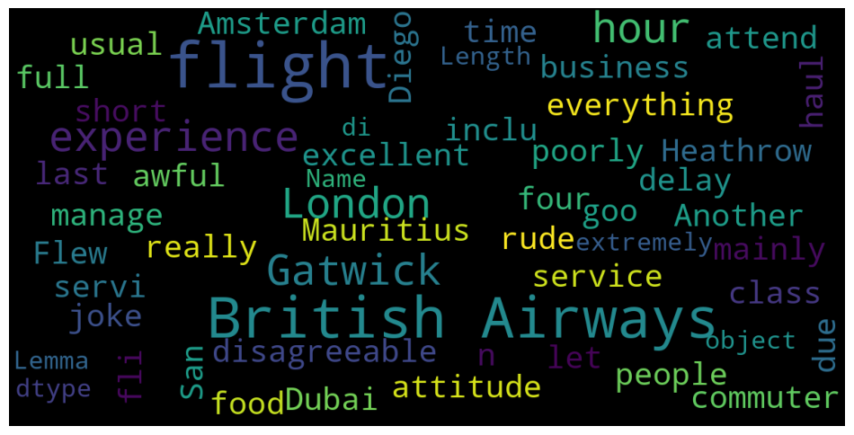
Word Cloud

